Slide 1

A Melomaniacs Guide to Film
Zach French
Film-1023
Fall 2023

Slide 2

Use of Music in Film
Communicates feelings and atmosphere
Sets pace
Influences interpretation
Develops Narrative

Slide 3

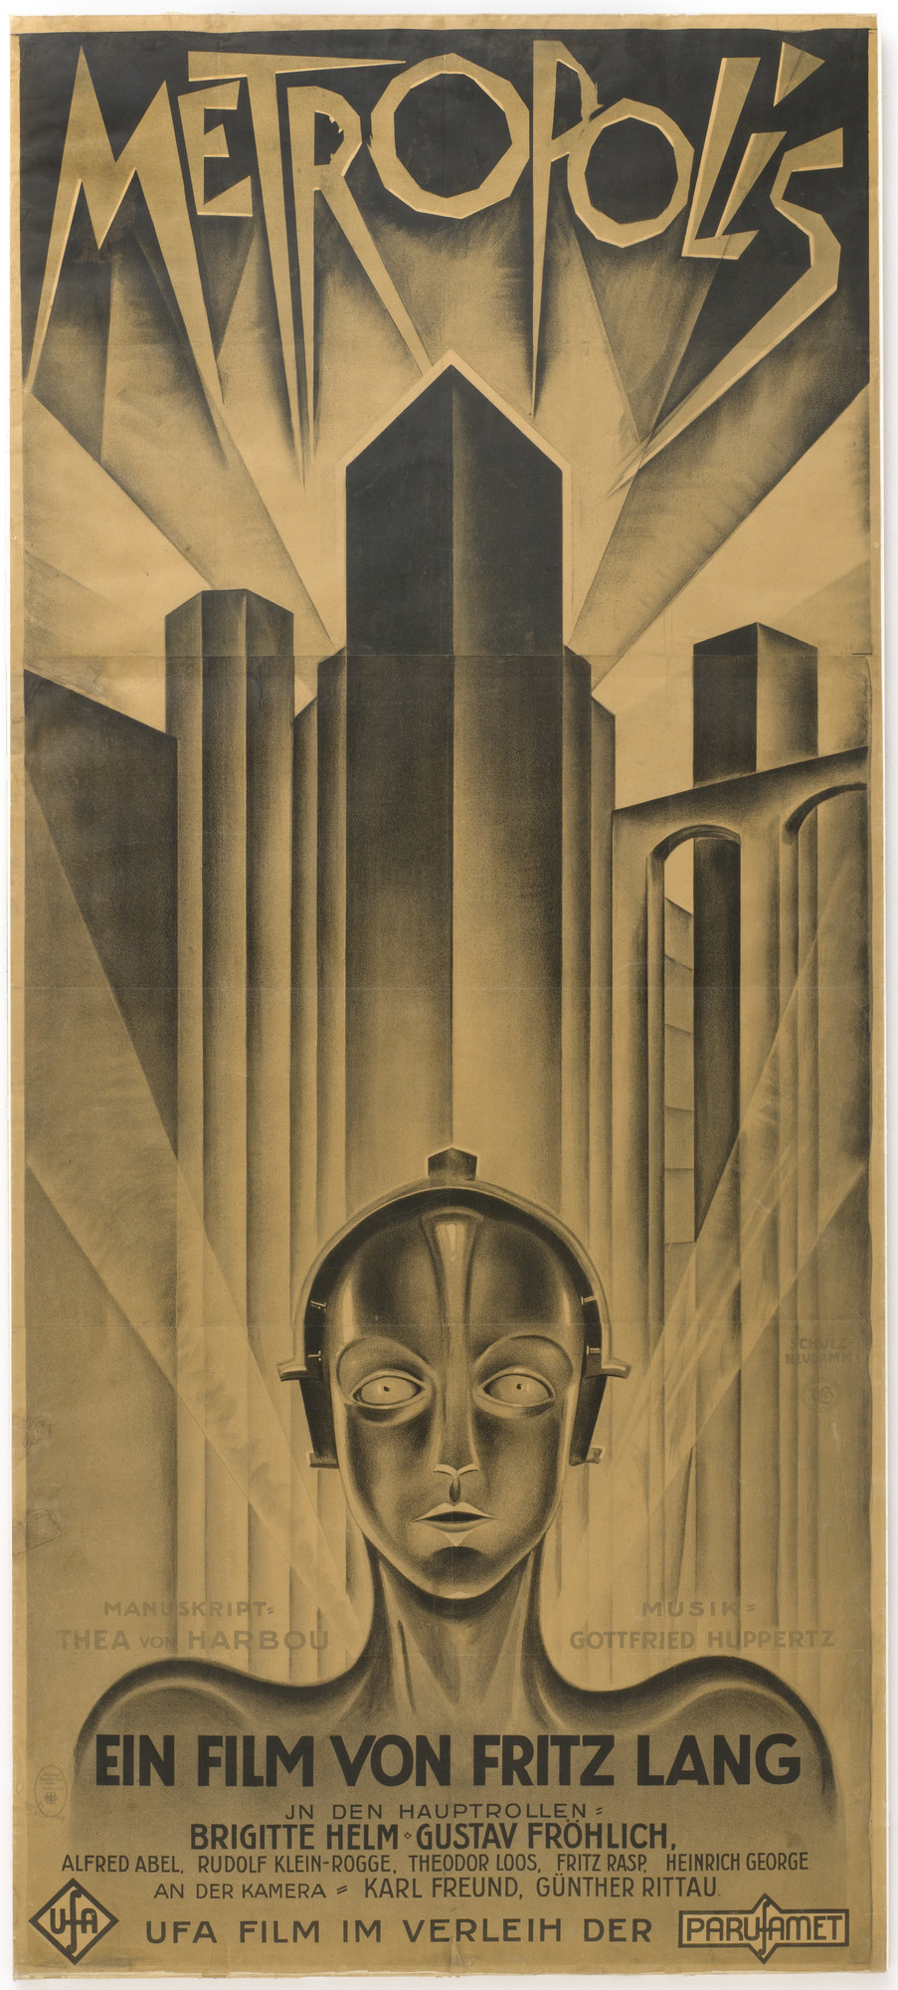
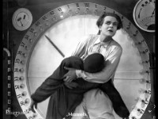
Fritz Lang’s Metropolis
Soundtracks were the only audio
  No voice or sound effects added
Important form of communication
to audience
Music used as SFX
Notes:
Title Sequence: 3:01
Workers on the Machine: 15:06

Slide 4
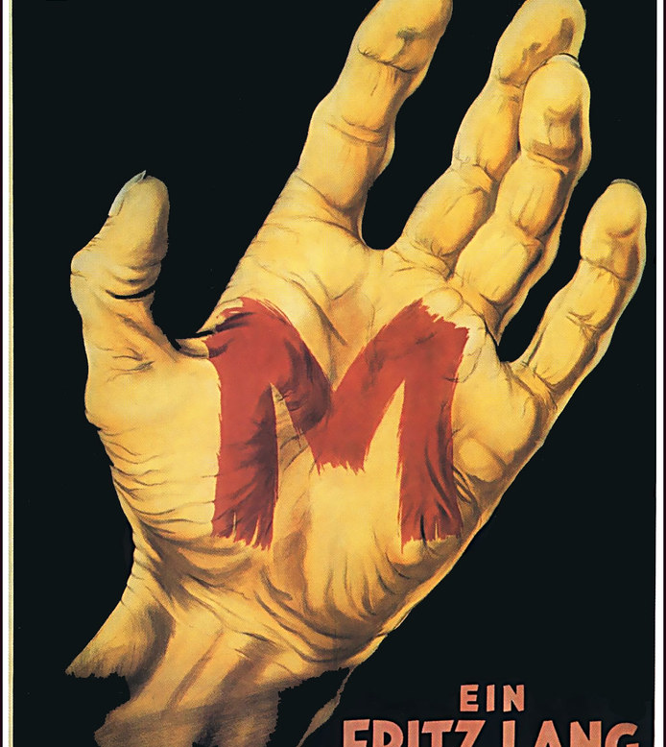
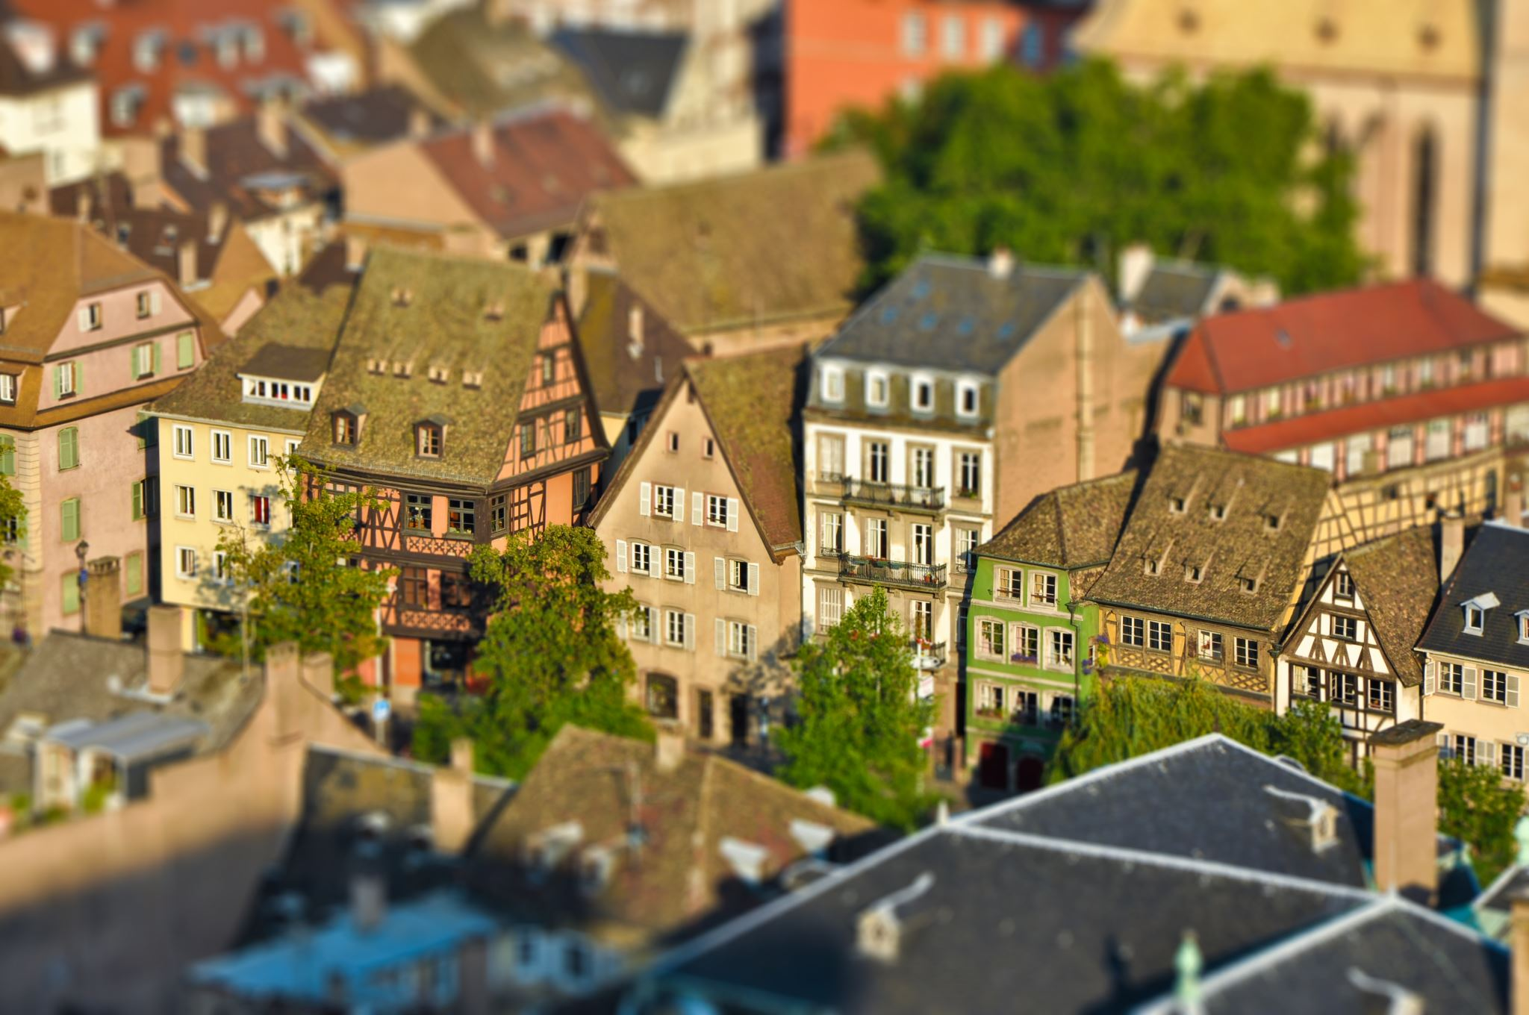
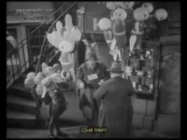
Fritz Lang’s M
Opposite of Metropolis
  No Soundtracks
  Highlights the motif
Signature villain motif
  Easily recognizable tune
    Peer Gynt- “In The Hall Of The Mountain King”
  Halloween, Psycho, Jaws, etc., have signature tune for the killer

Slide 5
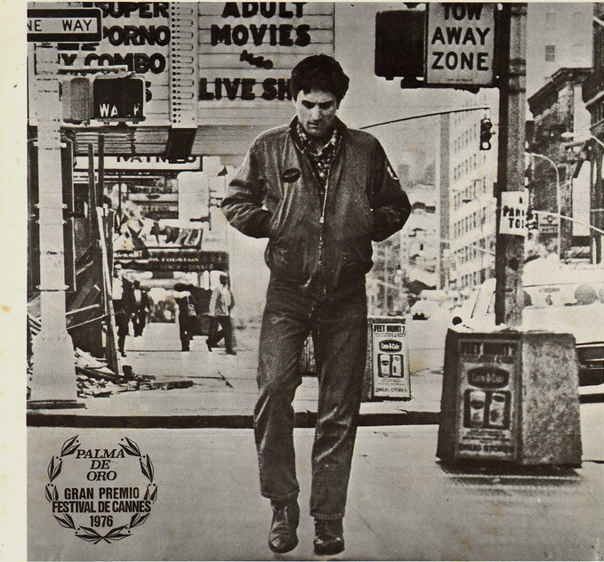

Martin Scorsese’s
Taxi Driver
Opening soundtrack
Bernard Hermann- Main Title (from “Taxi Driver”)
  Last work he would create
Communicates Travis’ setting and mind
  Trying to find a groove that is constantly interrupted
  Chaotic sounding music that differs
  Same motif throughout film

Slide 6
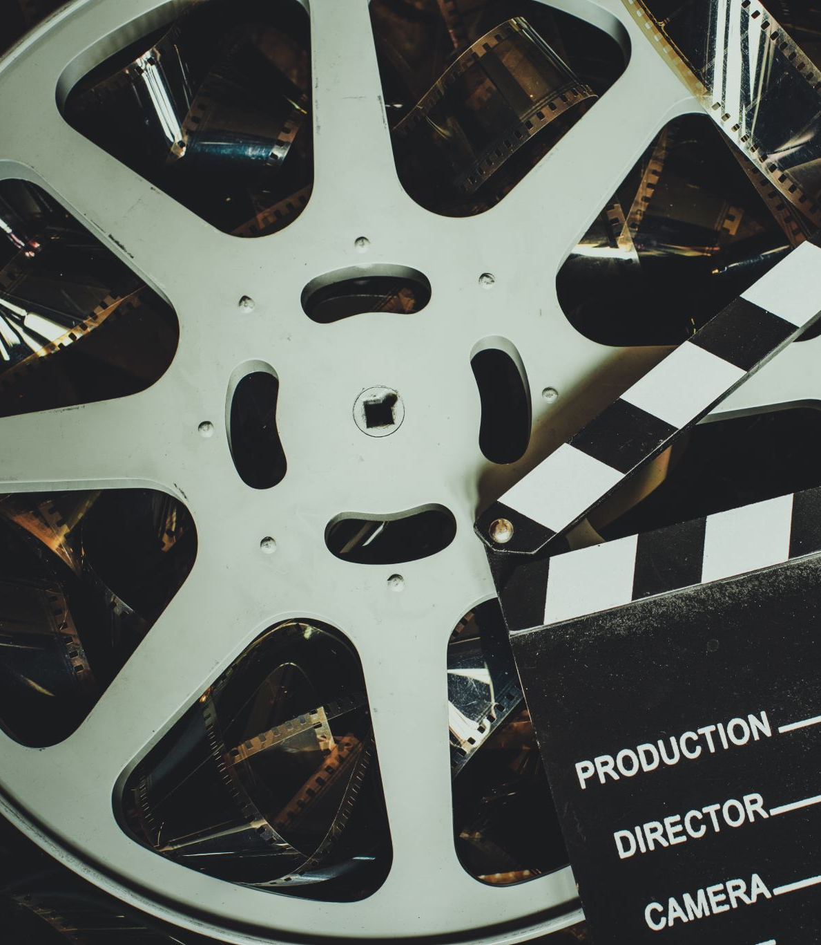
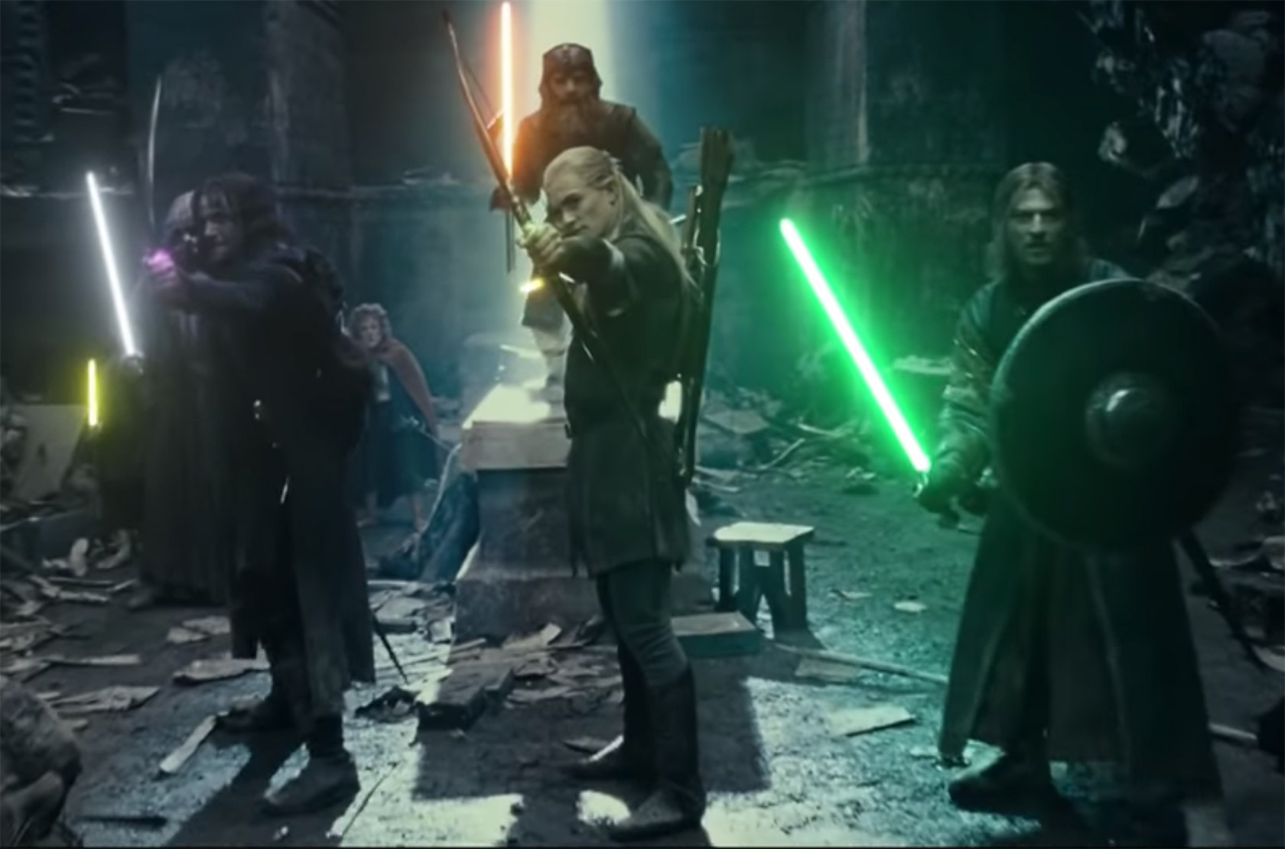
The Uniqueness of OST’s
Traits of great soundtracks in film
  Distinct and recognizable
  Interwoven with film and plot
  Motifs to other soundtracks within the film
Difficult to successfully mix and match
  Loses identity
  Miscommunication

