Slide 1

Film Face
The card game

Slide 2
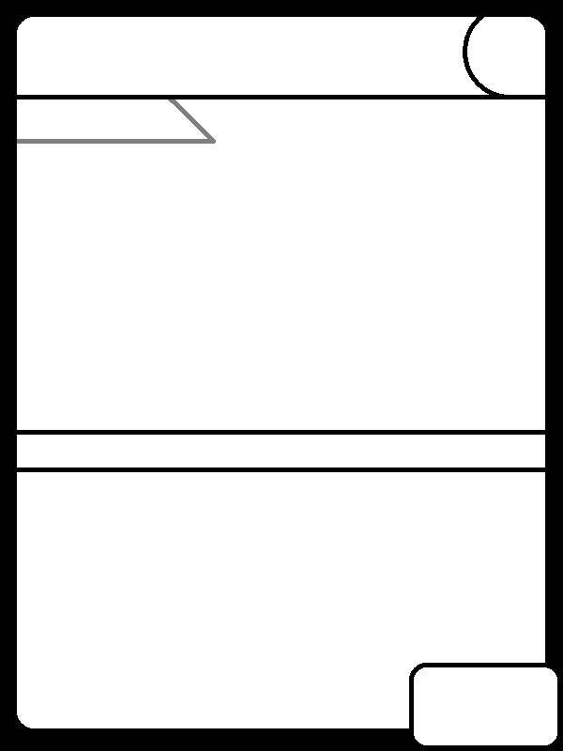




Movie quick identifier
James Bond Goldfinger
M .
M
Citizen Kane
12 Angry Men
Rope

Slide 3
Name of character
M- Mr. Beckert, Criminals, Police, Blind man
Set: Arrest one character for the game
Citizen Kane- Mr. Kane, Mrs. Kane(Singer), Mrs. Kane (1st), Mother
Set: 10 gems
12 Angry Men- Juror 3,4,8 and the accused
Set: Makes someone immune to being arrested
Rope- Brandon, Phillip, David, Mr. Cadell
Set: Murder -20 hp
Goldfinger- Bond, Goldfinger, Galore, oddjob
Set: Extra turn

Slide 4
Health Points (HP)
They are given a health from 10-30
It takes 3 turns to recharge once put in the recharge station

Slide 5
Picture (Hand drawn)

Slide 6
The character can use their power once as individual and once as a set.
Powers

Slide 7
Power ranking out of 5
Based on how powerful their skills are.

Slide 8
Recharge pad- one card per charge pad it takes 3 turns to recharge to full HP
Costs 1 gem
These are like wildcards not everyone will get one but they are the most useful.

Slide 9
2
3
1
4

Slide 10
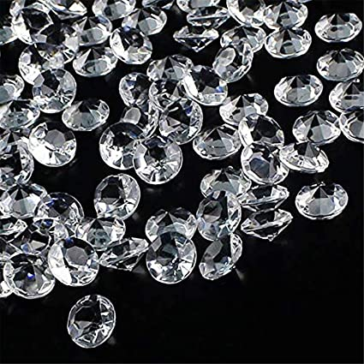
This is the games currency you can buy a card off of a player or can recharge dead characters.
You earn gems by killing off the other players characters. (You do not have to return the gems if the player recharges their character.)
Getting a new character costs 3 gems

Slide 11
Demonstration of Game play

